Slide 1
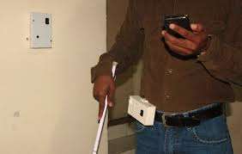
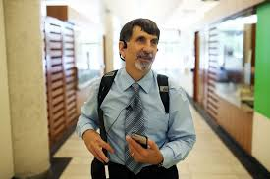
SMART NAVIGATION SYSTEM FOR THE VISUALLY IMPAIRED
Guides:
Dr. S. Joseph Gladwin ,Associate Professor
Dr. R. Rajavel, Associate Professor
A Project by :
P. Sivasankar S. Somasundar
K. Vimal Raj R. Ravishankar
M. Naveen Narayanan V. Prakash
DEPARTMENT OF ELECTRONICS AND COMMUNICATION ENGINEERING
SSN COLLEGE OF ENGINEERING

Slide 2
OUTLINE
Introduction to Smart Navigation System.
Objective of the Project.
Technical Aspects of the Project.
Outcomes of this Project.
Work Plan.
Conclusion and Future Directions.
Reference.

Slide 3
INTRODUCTION
Technological advances within the past decade have caused a surge in the proliferation of personal locating technologies.
Navigation systems that rely on the use of cellular communication signals do not provide sufficient accuracy for indoor navigation.
Navigation inside unfamiliar buildings is still accomplished by studying large maps posted in building lobbies.
If created, a system capable of locating a person and directing them to their destination would be more convenient and would provide functionality

Slide 4
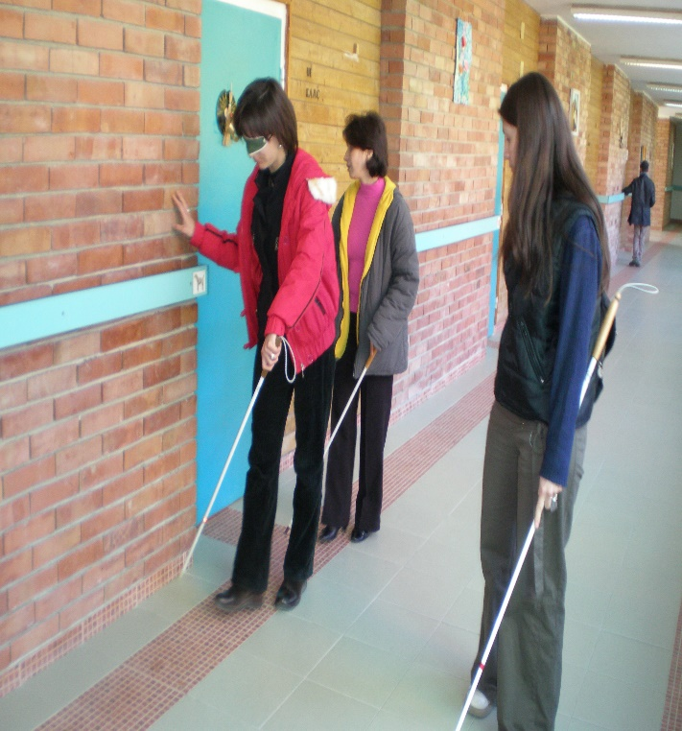
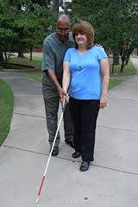
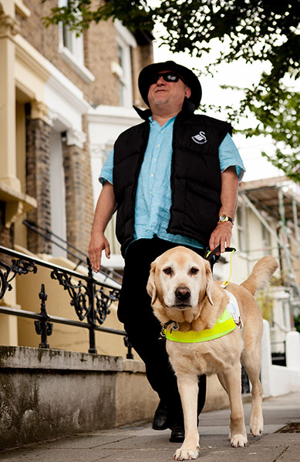
MOTIVATION
According to the WHO in 2014, 285 million people are estimated to be visually impaired worldwide.
Visually challenged people all over the world face difficulties in navigation, particularly in an unknown environment.
Most of them use normal canes or dog guides for their navigation.
Hence there is a need for a system to guide them in such cases.

Slide 5
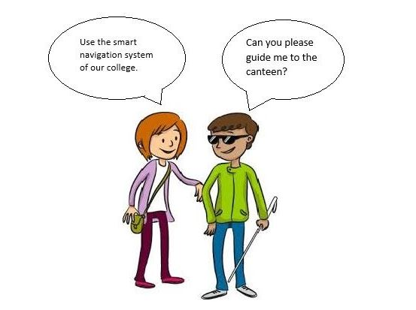
OBJECTIVE
The objective of the project is to
Develop a system using the current technology to enable indoor navigation for the visually challenged people.
Provide vocal assistance to the visually challenged using a microcontroller/ Wi-Fi transceiver which is connected to the Wi-Fi system in the building.
Based on the location of the person a voice message is sent to
the device.
In addition the smart cane will provide
vocal assistance for the nearby
obstacles

Slide 6
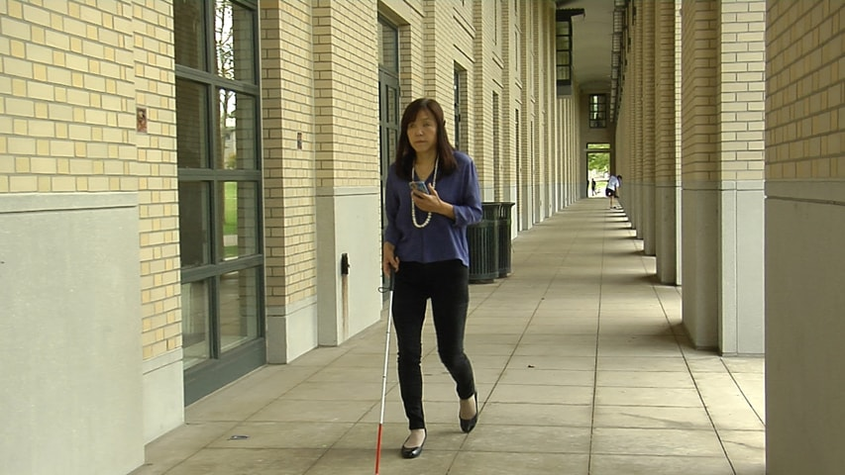
PROPOSED DESIGN
SMART HAND HELD DEVICE
This project is intended to develop a self-assistive in-door navigation.
The system makes use of wireless routers, placed at different locations in the building.
Wireless routers have a unique MAC address.
The user will be provided with a wireless transceiver.
When the user is near a Wi-Fi router, the device will get paired up.
The server identifies the connected router.
The required direction information, is sent back to the intended device as an audio file.
The audio file is played using a headphone.

Slide 7
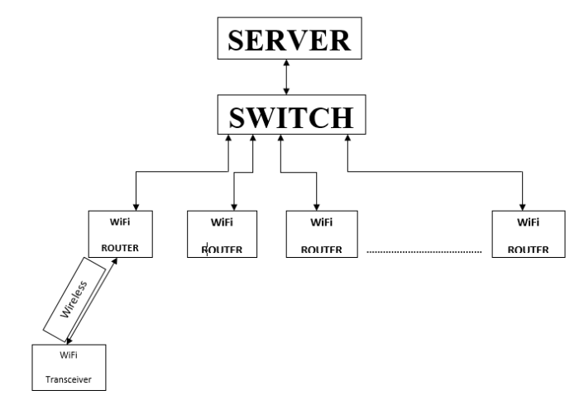
BLOCK DIAGRAM

Slide 8
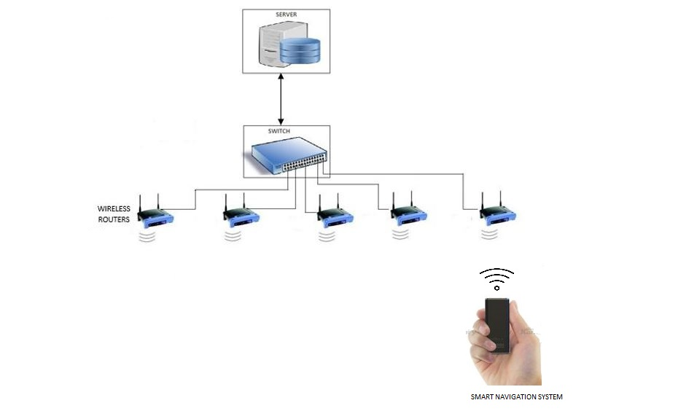
SCHEMATIC DIAGRAM

Slide 9
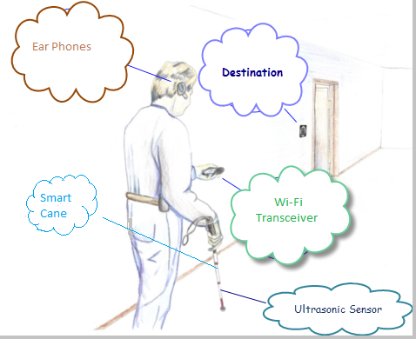
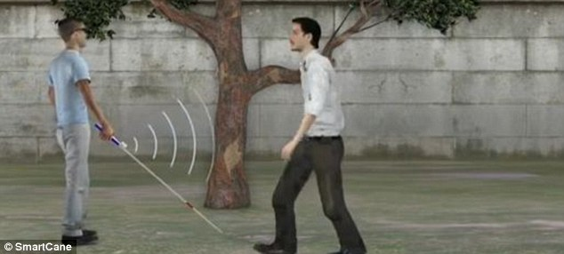
PROPOSED DESIGN
SMART CANE
The ultrasonic sensors will be placed on the white cane.
The sensors will detect any obstacle.
The microprocessor in turn is connected to the device and the server .
When the sensor senses an obstacle, a vibration is produced on the cane.

Slide 10
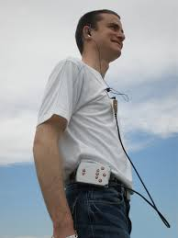
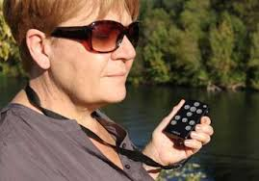
OUTCOMES:
The proposed solution will provide better safety measures for the visually impaired in navigation as shown in figure.
This will reduce their dependency on others and also increase their confidence while navigating in unknown locations.

Slide 11
WORK PLAN - METHADOLOGY
setting up a server that stores different audio files.
Replacing the mobile phone with a microcontroller (with Wi-Fi module) that has a 3.5mm audio jack.
Connecting the router to the server.
Finally, expanding the system with many Wi-Fi routers and Wi-Fi transceivers.
When a mobile is connected to the Wi-Fi, the MAC address of the router is sent to the server.
Using the MAC address as an identity the required audio file is sent back to the mobile.

Slide 12
WORK PLAN
S.No. | Student Member Name | Role (Choose one of the following – Marketing, Technical, Operations & Other Roles as applicable) | Justification
1 | NAVEEN NARAYANAN M | TECHNICAL | In charge of designing the handheld device with microcontroller
2 | SOMASUNDAR | TECHNICAL | Responsible for designing the smart cane and codes the microcontroller
3 | VIMAL RAJ | OPERATIONS, TECHNICAL | Sets up the server with different audio files
4 | SIVASANKAR | MARKETING, TECHNICAL | Compares prices of similar products available in the market
5 | RAVISHANKAR | TECHNICAL | Research
6 | PRAKASH | MARKETING, OPERATIONS | Sets up Wi-Fi system in the building, makes the smart cane and helps in coding

Slide 13
OUTCOME

Slide 14
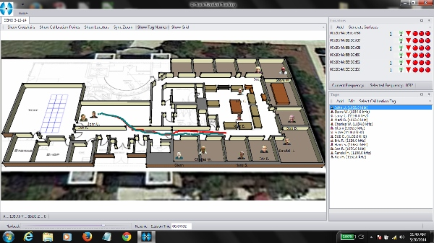
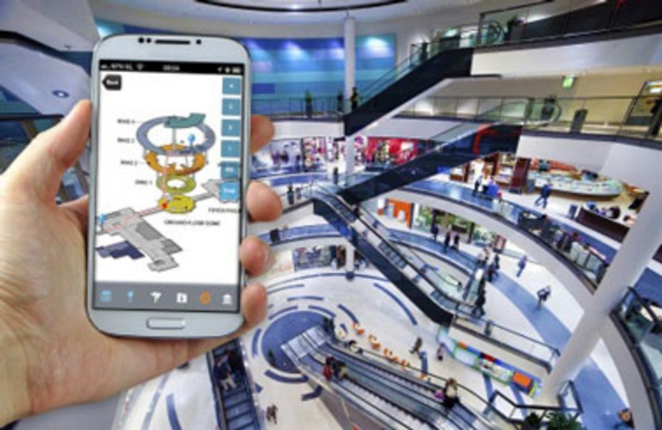
FUTURE DIRECTIONS
Extending the project for outdoor navigation using GPS.
The location of the person can be traced from the server.
Apart from voice messages for directions, other information can also be provided. Example, If this system is implemented in a mall, then information such as the details of the shops and the offers available in that shop can also be sent in the form of voice messages.

Slide 15
REFERENCES
Websites:
1. www.google.com
2. http://indiatoday.intoday.in/story/india-blind-newsflicks-eyes-bin/1/428125.html
3.http://www.who.int/mediacentre/factsheets/fs282/en/
There has already been a great deal of work done both in India and
abroad in the area of indoor navigation. Although the area of indoor navigation using Wi-Fi is less mature, there have been some recent breakthroughs. Here we list few ongoing researches in this field:
Papers:
1. The GuideCane-applying mobile robot technologies to assist the visually impaired
Author(s) I. Ulrich ; J. Borenstein a IEEE paper.
2. Application of WiFi-based Indoor Positioning System in Handheld Directory System
Author(s) LEE PIEH WEN, CHAN WEE NEE, KHOR MENG CHUN, TAN SHIANG-YEN, ROSNAH IDRUS, School of Computer Sciences, Universiti Sains Malaysia, MALAYSIA

Slide 16
CONCLUSION
The proposed solution will provide better guidance for navigation and obstacle free movement for the visually impaired people.
This smart self-assistive navigation system will provide voice based guidance as an alternate to current conventional cane.
The proposed system can be implemented in large buildings such as malls, banks, hospitals, schools, offices and in other areas with inbuilt Wi-Fi system.
It will offer guidance to almost 15 million of the people in this country.

Slide 17
THANK YOU

